Slide 1
Western Mass MRC 101
Medical Reserve Corps Core Competencies Training
Introduction and Orientation
Notes:
Show video “ Introduction to MRC”

Slide 2
Welcome
The MRC Experience
…gives you an opportunity to work and train with a group of people, who like yourself, want to be part of the solution when disasters or public health emergencies happen.
Notes:
What is the MRC

Slide 3
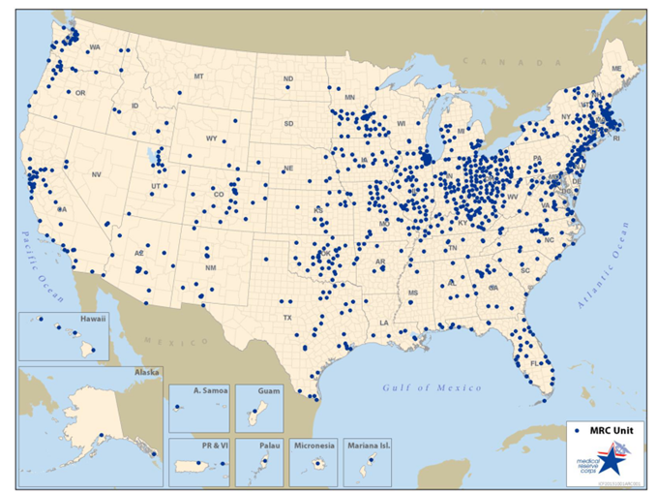
We’re Everywhere
792 units and 73,730 volunteers in 2009
997 units and >202,554 volunteers in 2015
Notes:
It’s a national organization
Part of the Surgeon Generals Office
In Hampshire County units at UMass, Nonotuck, Amherst and South Hadley
Western Mass is also organized with units in Hampden, Franklin and Berkshire
Units throughout Massachusetts
See the website at www.wmmrc.org

Slide 4
Freedom Corps

Slide 5
Volunteers
Who?
people of all ages, from all walks of life
clinical and non-clinical
What?
your role depends on your physical ability, training, expertise and interests
How?
all service is voluntary
Notes:
Who
People from all walks, varied skills
Medical
Nurses,
Pharmacists
Physicians
Dentists
Veterinarians
Mental Health Specialist
Non Medical
Drivers
Interpreters
Data specialist
Young and retired (with or without current license)
Requirement
ICS 100/ NIMS 700
Introduction to MRC

Slide 6
Community Partners
public safety
public health
hospitals
MAResponds.org – our volunteer registration system
volunteer partners (DART, CERT, American Red Cross)
community and faith-based organizations
COAD (Community Organizations Active in Disasters)
Notes:
Emergency Medical Services (EMS) Medical stabilization and transport
Police Civil Order and Criminal Acts, including terrorism
Fire Fires, Spills and Explosions
Board of Health – Infectious diseases, food, water, housing, Public Health
VNA or Public Health Nurse Infectious Diseases, Home Care
DPW Provide support and equipment
Partners
Other Town or City Employees Provide support
HAZMAT and DEP Rapid Response Teams
Hospitals
Citizen Corps
CERT Community Emergency Response Teams
MRC Team Leaders Medical Reserve Corps
Fire Corps and VIPS Volunteers in Police Service
Search and Rescue, etc..
Volunteer Organizations like American Red Cross (ARC) and others.
Community Partners like Schools - Churches - Businesses – Individuals

Slide 7
Organizational Structure
Federal MRC (Assistant Secretary for Preparedness and Response)
MA MRC
Western MA MRC
Special Teams
County MRC
MRC Units
DART Teams
Notes:
Could mention Units and Team…e.g. DART Team…..children in disasters team

Slide 8
What we do
Mission
We build resilient and healthy communities
Vision
Individuals and communities committed and totally ready to manage all hazards
Notes:
Purpose: The mission of the Medical Reserve Corps in Western Massachusetts is to improve the Promote Public Health and safety across the region in 3 key areas;
Public Health Emergencies: disease outbreak, chemical release
Mass Casualty Incidents: threats to large numbers of people: storms, floods etc.
Community Service Activities: health fairs, training, e.g. flu care at home

Slide 9
Funding
federal funding in the form of grants
state funding to Western MA regions
some units have 501c3 status and can fundraise
most units rely on in-kind support from their host communities

Slide 10
Core Values
Community: we honor community based volunteerism
Action: we support public health volunteerism and service
Resourcefulness: we create opportunities to learn and develop relationships and resources
Teamwork: we collaborate and work together
Diversity: we accept and respect cultural identity

Slide 11
Our Strengths
Volunteers
are pre-identified
have verified credentials
receive training
complete and pass background checks
Notes:
Professional licenses and certificate verification
CORI/SORI background checks

Slide 12
Volunteer Involvement
Tier 3 - Leadership
Tier 2 - Active
Participates in training,
exercises & events
Tier 1 - Basic
Emergency only

Slide 13
MAResponds: www.maresponds.org
A secure statewide database of pre-credentialed volunteers, managed by the Department of Public Health
volunteers maintain a profile including contact information, credentials and training records
Criminal Offender Record Information Acknowledgement Form
used to contact volunteers about training, unit activities and deployment opportunities via
email
phone
or text message

Slide 14
Training Opportunities
Based on core competencies
Required
MRC 101
Incident Command (ICS)
Psychological First Aid
Optional
CPR/First Aid, emergency dispensing, shelters, pandemic flu, hazardous materials, threats etc.
“Just-in-Time” training
Exercises, workshops and conferences
Notes:
Required
MRC 101
ICS
Behavioral Health/Disaster First Aid
Optional
Other optional training e.g. CPR, EDS, PPE, Family Preparedness, Shelter Volunteer; Bioterrorism; Category A agents

Slide 15
Volunteer Learning Paths
Volunteer Core Competencies are categorized by:
Preparedness
Response
Leadership
Support for Community Resilience
Each Leaning path has associated Core Competencies

Slide 16
Volunteer Preparedness
Personal and Family
Preparedness and safety
C1
C5

Slide 17
Practice the Life Safety Code
FIRST …protect yourself
THEN …others
THEN …control the incident
THEN… save property and the environment

Slide 18
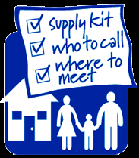
C-1 Demonstrate personal and family preparedness
have a family preparedness plan
know about
school plans
workplace plans
local plans
your friends and neighbors’ plans
Complete a personal and family preparedness plan
Notes:
Can’t help others if you aren’t ready yourself.
You and Your Family Come First
Family Emergency Plans
Caring Networks of friends and family
Learn about local emergency plans
Show 72-hr kit video…12 minutes
Distribute Family Plan sheet

Slide 19
Make a 72-hour Plan
You should plan on taking care of yourself and your family for 72 hours. View this training:
Resources (click for video)
www.wmmrc.org
www.ready.gov
Notes:
Hand out check list
Show 72 hour kit
Talk about strategies for getting long-term supplies
Emergency Supplies to last 3 to 12 weeks
Water.
Every week add some canned goods and paper products to your pantry or box under your bed.
Rotate your supplies as needed.

Slide 20
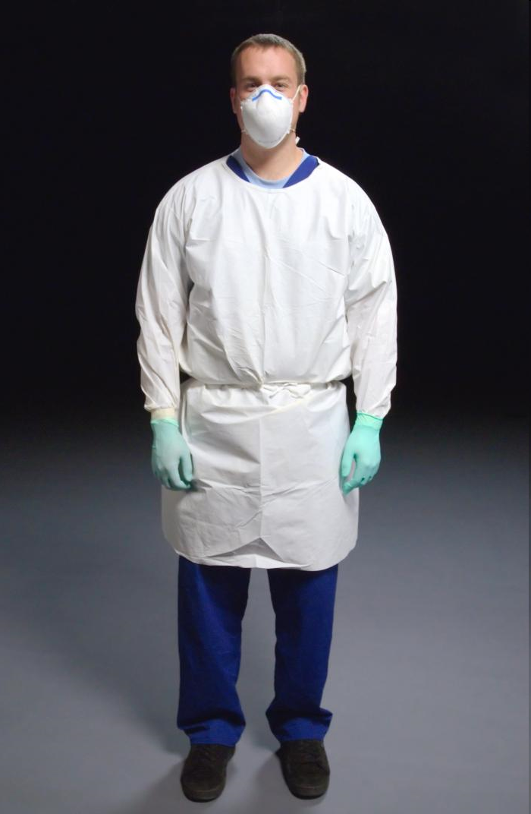
c-5 Demonstrate knowledge of personal safety measures
Learn about and use standard precautions
Ask for training about how to use personal protective equipment (PPE)
Demonstrate safe behaviors during MRC activities
Notes:
Have a PPE kit to show
Take care of yourself first
Ask for appropriate Personal Protection Equipment (PPE) training
Just in time at an event
Take a PPE course through the MRC
Know the proper way to put on and take off masks, gloves and goggles
Handout on Universal precautions

Slide 21
Practice Healthy Habits
Your best protection is a strong immune system, so…
eat well, get plenty of rest and exercise
follow good hand washing and cough etiquette practices
use sanitizer frequently
Notes:
Remember what your mother said
Eat well
Get plenty of sleep
Exercise

Slide 22
Volunteer Response
C2
C4
C6
C7
MRC Response plans, Communication, Roles, and Service implications

Slide 23
c-2 Demonstrate Knowledge of Your Expected Role in Response Plans
Activation, reporting and demobilization
Professional and ethical conduct
Incident command system

Slide 24
We Provide Support During Four Stages of an Emergency
PROTECT
RESPOND
RECOVER
PREVENT
Notes:
Mitigation:
Reduce the effects of an emergency by reducing the number of people and places that will be affected
Example - raising bridges so that they don’t flood.
Social distancing measure when the flu first appears
MRC Units and members should be community advocates for mitigation work.
Planning: Strategic and operational plans
Examples of some types of plans
Communication plans
Risk Communication plans….to work with the public
EDS plan
Pandemic Flu Plan
Continuity of Operations Plans
ISCU Plans
MRC units should be advocates and partners in the planning for All Hazards
Response:
Emergency Operations Center (EOC)
Control the Incident – MRC Roles
Provide a community reservoir of trained, credentialed volunteers
Staff Emergency Dispensing Sites (EDS)
Staff Influenza Specialty Care Units (ISCU)
Support Local Board of Health (LBOH)
Support Sheltering Efforts including Medical and Animal Care Units
Recovery: Bring things back to normal

Slide 25
the MRC Emergency Response Role
The MRC fills a support function: we are not first responders.
We:
support public health and public safety responders
follow established protocols and job descriptions
follow the incident command system
work within our training, capabilities and licenses

Slide 26
Activation Methods
Know your unit’s notification system:
Health and Homeland Alert Network (HHAN)
e-mail from Unit Coordinator
MAResponds email, phone or text
phone tree
social media
update your information regularly with your coordinator and on MAResponds www.maresponds.org
check information at www.wmmrc.org
Notes:
Activation procedures
Volunteers requested by State, Board of Health, Emergency Management Director, or Hospitals
Volunteers contacted by phone, email, HHAN (Health and Homeland Alert Network)
Keep your contact info up-to-date: when it changes or with periodic requested update
Check the website www.wmmrc.org

Slide 27
Activation, Reporting and Demobilizing
Only unit coordinators will request volunteers
never self-deploy…this is grounds for dismissal
follow activation instructions
receive your incident assignment:
reporting location and time
expected length of the assignment
Job Action Sheet
communications plan
Follow activation, reporting and demobilization procedures
Notes:
NEVER self-deploy
Follow activation instructions
Report when and where instructed..
Ask about getting through security and parking
Carry proper photo I.D., including a current MRC Badge if available
Bring along some basic supplies like a change of clothing, food and water, your medications - just in case supplies are limited.

Slide 28
What to Bring
carry government issued photo ID and your badge
wear your MRC uniform/t-shirt/hat
wear appropriate clothing (wet, cold, heat)
bring basic personal supplies e.g. medications, sunscreen, bug spray, water, snacks, etc.
bring specialized supplies or equipment required

Slide 29
At Your Assignment
always sign in and sign out
obtain a briefing
if you don’t understand your job: ASK!
participate in Just-in-Time training
get required forms and work material
ask about security and report concerns
complete required forms

Slide 30
After your assignment
help with the demobilization
return supplies and equipment
return completed forms
sign out on-site
report to your unit coordinator
participate in after action meetings and reports

Slide 31
Personal Limitation Awareness
If you are unsure about your job limits, ask!
Work within the scope of your :
professional license
personal ability
training
job description
Incident Command Structure position
Notes:
Know your physical and emotional limits. If you collapse, you become part of the problem instead of the solution.
Know your training limits – you must stay within the scope of your training and skills. Just-in-time (on the job) training will be used for many critical tasks during an emergency. As long as you stay within the scope of your training and skills, you are better able to protect yourself and others.
Remember, you are responsible for protecting yourself first and then others.

Slide 32
Principles of Operation
Deployment is voluntary and follows these principles:
We treat all with respect
We honor all volunteers
We communicate clearly
We ensure volunteer safety (ourselves and others)
We work within our credentials, training and comfort level
Notes:
Volunteers must sign a Code of Conduct and Confidentiality Agreement
Dismissal for violation of Code or Confidentiality

Slide 33
Volunteer Expectations
complete all required training
sign and follow the MRC Confidentiality Agreement
sign and follow the MRC Code of Conduct
complete criminal offender checks
provide current credentials
Follow policies and procedures related to professional and ethical representation of the MRC

Slide 34
Serious breaches of Conduct
Volunteers may be dismissed according to procedures outlined in the policy manual for:
dishonesty
breach of confidentiality
unsafe work habits
violation of the Code of Conduct or other agreements
Inappropriate substance use
unsatisfactory CORI/VSOS check

Slide 35
Incident Command (ICS) Pyramid
Incident
Commander
Public
Information
Officer
Safety Officer
Liaison Officer
Operations
Planning
Logistics
Finance/
Administration
MRC

Slide 36
Understand and follow ICS
standardized system used by all responders
clear management structure with unity of command; i.e. one leader
common terminology for positions, procedures and equipment
flexible - expands and contracts as needed
defined roles and responsibilities
span of control of 5-7 people
go to FEMA for online training at training.fema.gov
Describe the chain of command during MRC activities
Notes:
Describe the chain of command, MRC integration, and its application to a given incident.
Explain span of control

Slide 37
C-4 Communicate Effectively
do not talk to the media unless authorized to do so
refer media to your supervisor or the Public Information Officer (PIO)
check for social media guidelines
know how to use communication equipment
understand communication protocols
maintain confidentiality (verbal, written and photos)
always be open, direct and tactful
Describe communication responsibilities and procedures
Notes:
In the ICS structure the Public Information officer authorizes people to speak to the press.
Learn radio and other communication protocols before using communication equipment.
Take time to communicate calmly, clearly and completely with your team leader and others
Know the HIPPA laws and protect the medical privacy of others
Distribute Confidentiality Agreement

Slide 38
Communication in Emergencies
Usual methods may not work in stressful situations
Communicate:
simple, plain language
slowly, clearly, loudly
repeat the message
use multiple communication channels
ask if they understood the message

Slide 39
C-6 Understand the MRC emergency Response Role
Surge Capacity
MRC units assist with a variety of response activities:
emergency dispensing at public and closed sites
emergency shelters
pet shelters
Volunteer Reception Center management
support first responders, e.g. firefighter rehabilitation
Describe how the MRC serves the community

Slide 40
MRC Non-emergency Roles
provide community education and outreach, including public awareness campaigns for personal preparedness
help at annual flu clinics
assist those with Access and Functional Needs
participate in training and exercises
participate in emergency plan development
attend MRC, COAD, DART, CERT, HAM radio meetings

Slide 41
Behavioral Health Principles and Practice
Understand Principles and Practice
for clinical management
C7

Slide 42
C-7 Understand the Impact of an Emergency on Behavioral Health
Stress is a normal person’s normal reaction to abnormal situations
You come first! Protect yourself…
take breaks
eat well…exercise
beware of your stress level and that of your co-workers
do not self-medicate - alcohol and drugs are not the answer to stress
ask for help if you need it
Identify the behavioral health impact of an event on an MRC volunteer, their family, team and the community.
Notes:
Critical Incident Stress happens to responders as well as victims.
Stress is normal..
Exercise, take care of yourself, take breaks, eat right,
Stress can often lead to substance abuse (food, alcohol, drugs, cigarettes, etc..). Don’t use “a little something to take the edge off.”

Slide 43
Behavioral Health/ First Aid
it’s the little things…
“How can I help?”
don’t presume to know…ASK
acknowledge problems
provide constructive action ideas
be calm, considerate and compassionate
be aware that we all react differently to a crisis
learn about and respect cultural diversity
just listening can be the most important thing
Notes:
. – Take additional trainings
Giving someone a drink of water can be important and just what they need.
Never tell a victim that you know just how they feel. Acknowledge their problems and when possible, give them something constructive to do.
Be aware that in a serious crisis, all affected people take in, process, and act on information differently. It is normal to see behavioral extremes and have difficulty communicating

Slide 44
Volunteer Leadership
Situational Awareness
and Public Health principles
and practice for management of all
C3
C8

Slide 45
C - 3: Situational awareness
attend optional MRC training about hazmat, terrorist , biological and environmental emergencies
anticipate deployments by watching the news
monitor social media
watch for alerts from your unit leader
during deployments attend briefings

Slide 46
C - 8: Serving all populations
In disasters we need to be ready to serve the basic needs of all those represented in the community
Cultural Needs
Safety
Medical Care
Language
Food and Religion
Gender differences
Access & Functional Needs
Communication
Medical
Independence
Supervisory
Transportation
Demonstrate cultural humility and
know how the MRC serves the community

Slide 47
Serving Those with disabilities and Access & Functional Needs: C-mist
During an emergency many people will have access and functional needs. MRC cares for all.
C - Communication: limited or no ability to speak, see, hear or understand
M - Medical: chronic , contagious or terminal illness
I - Independence: need assistive devices or assistance
S - Supervision: children, some elderly and those with mental health issues, addiction etc..
T - Transportation: disability; poverty, legal restrictions
Notes:
CMIST stands for:
Communication- those with limited or no ability to speak, see, hear or understand. During an emergency, people with communication needs may not be able to hear announcements, see signs, understand messages or verbalize their concerns.
Medical-People who need help with managing activities of daily living such as eating, dressing, grooming, transferring and going to the toilet. It includes managing chronic, terminal or contagious health conditions. Early identification of these needs and intervention can avoid deterioration of health.
Independence- people who are can function independently if they have their assistive devices and/or equipment or personal aids/animals. Those at risk whose needs are recognized and restored early are able to maintain their independence and manage in mass shelters. Effectively meeting their functional needs prevents secondary complications.
Supervision-People with supervision needs may include those who have psychiatric conditions; addiction; brain injury, anxiety, also young children. During an emergency, some people with mental illness may be able to function well while others require a more protected and supervised setting.
Transportation-Emergency response requires mobility and this category includes people who are unable to drive because of disability, age, temporary injury, poverty, addiction, legal restriction or have no access to a vehicle. Wheelchair accessible transportation may be necessary.

Slide 48
Cultural humility
culture is a predominant force in our lives
everyone has both personal and group identities
diversity within cultures can be vast and significant
each individual and group has unique cultural values and needs
Be aware of and open to this diversity

Slide 49
The Process of cultural competency
be open and seek to understand…ask about culture
during a disaster people often cling to their cultural identity: anticipate and accommodate
consider language barriers, cultural differences in gender roles, the role of children, diet, religion etc..
take advantage of the opportunity for personal and professional growth
Demonstrate cultural humility during MRC activities

Slide 50
Volunteer support for community resiliency
C9
C10
C11
Ethic and Legal Principles and
Recovery Consideration

Slide 51
C-9 Ethical principles
respect the rights and dignity of all volunteers and clients while representing the MRC
do not disclose confidential information about volunteers or clients
contact the unit leader if you believe any confidential information has been disclosed
use honor, integrity, fidelity, and ethical behavior to guide decisions under challenging circumstances.
Follow policies and procedures related to professional and ethical representation of the MRC

Slide 52
C - 10: Understand legal principles that protect health and safety
Liability protection is varied and coverage depends on working within:
your job description
your credentials
the situation
community protections
Federal Volunteer Protection Act and State Good Samaritan laws apply
Demonstrate safe behaviors during MRC activities

Slide 53
C- 11 Understand short and long-term recovery Issues
more traumatic events occur within minority and marginalized groups …with greater risk for negative health/behavioral health outcomes
disaster may re-traumatizes refugee population who have fled war, famine, genocide
children need support through the traumatic stressors and loss
cultural liaisons can assist with understanding these behavioral health issues and trauma
Identify the health and behavioral health impacts of disasters
Notes:
e.g. the Springfield tornadoes in 2011 affected areas where majority populations were refugees and immigrants
Katrina : many long-term negative health outcomes due to trauma and stress

Slide 54
MRC Recovery Activities
after deployment the MRC may offer critical stress management for volunteers, as needed
the MRC is part of the Community Organizations Active in Disasters (COAD), an organization with a focus on recovery
active recruitment of volunteers with expertise in Access and Functional Needs, children in disasters and mediation/ombuds skills who can assist during and after an emergency
training and educational opportunities

Slide 55
Contacts
People and Websites

Slide 56
Website Resources
Western MA
www.wmmrc.org
State
www.mamedicalreservecorps.org
www.mass.gov/dph
www.sites.bu.edu/masslocalinstitute/
www.mass.gov/mema
National
www.medicalreservecorps.gov
www.ready.gov
www.pandemicflu.gov
www.cdc.gov
www.mrc.
train.org

Slide 57
Contacts: www.wmmrc.org
County Coordinators
Berkshire | Corinne McKeown | 413-528-0251 | cmckeown@wmmrc.org
Franklin | Robert Quinn-O’Connor | 413-774-3167 x137 | CitizenCorps@frcog.org
Hampden | Lois Luniewitcz | 508-450-4226. | loisluniewicz@comcast.net
Hampshire | Loren Davine | 413-429-6363 | lorendavine@gmail.com

Slide 58
Thank you for being the response!
Western Ma Medical Reserve Corps

